Slide 1
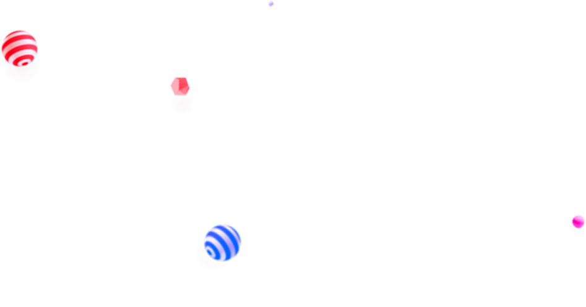
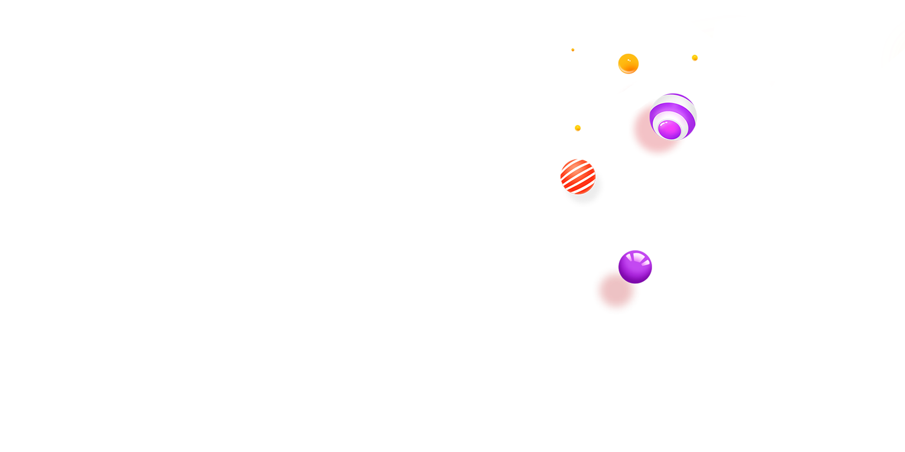
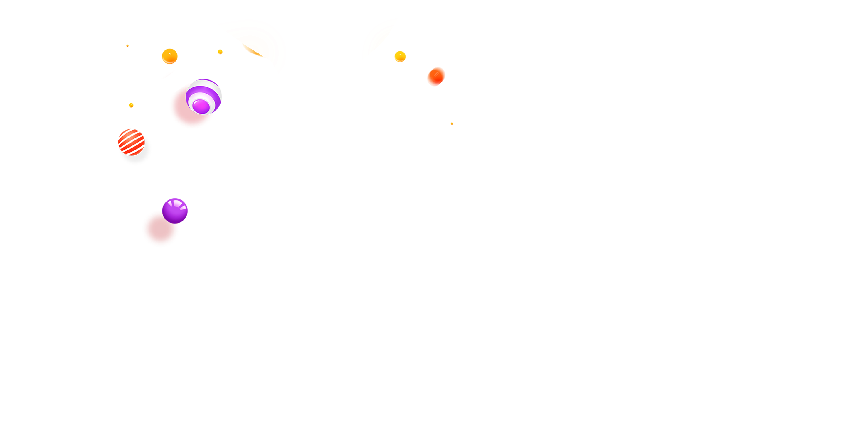


Governance token
MAI introduction to ecology
EN V1.1
www.mdefi.me

Slide 2
contents
Section 1
Section 2
Section 3
introduction
About us MAI
Play system

Slide 3
Section 1
Background
introduction
Create an ecosystem and token incentive model based on DeFi, NFT, and GameFi

Slide 4
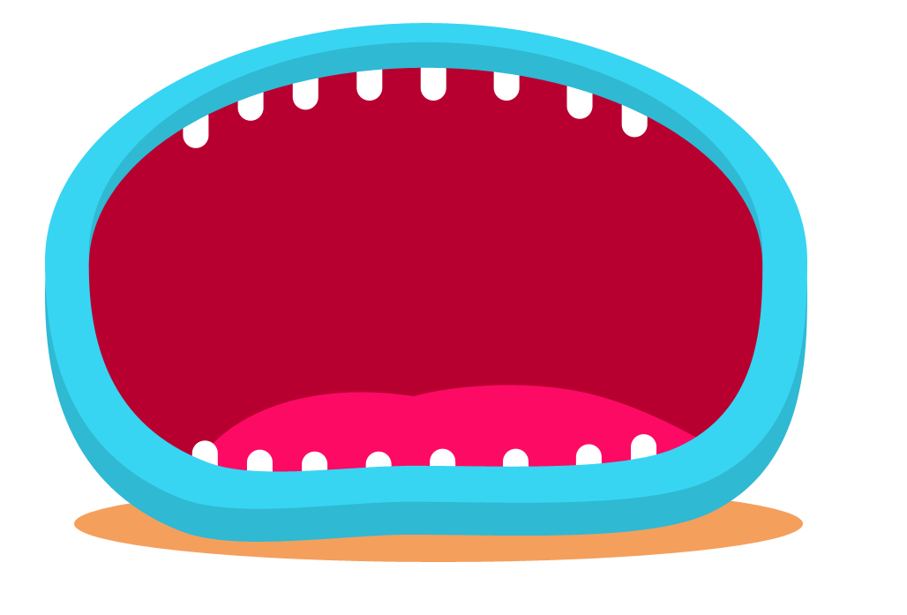


Millionaire · Blockchain background
Trillions of dollars
300 million
The number of investors in blockchain encrypted digital assets is conservatively estimated to exceed 300 million
The trend of asset digitization has taken shape. The Internet of Things, big data, artificial intelligence, and asset security requirements have promoted asset digitization. As of 2022, there are more than 11,000 types of encrypted digital assets worldwide, and the asset scale reaches trillions of dollars at its peak.
Blockchain background

Slide 5
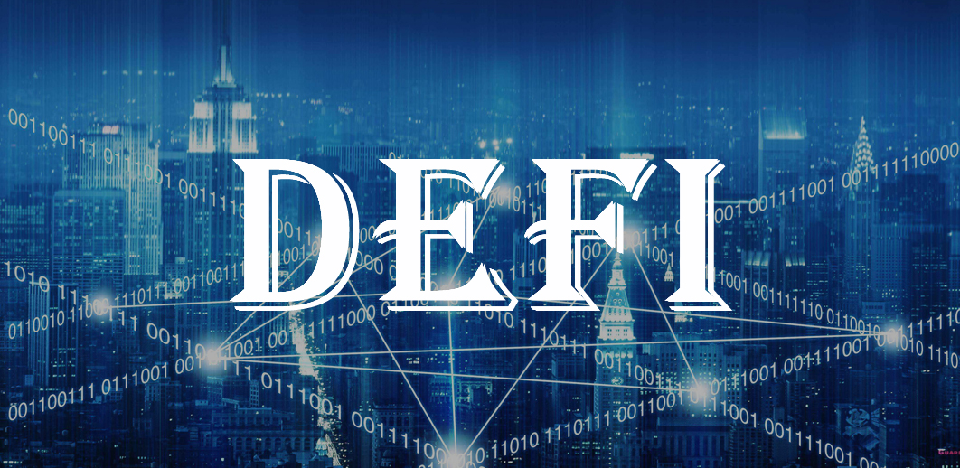
Millionaire · DeFi's continued prosperity
Decentralized Finance
DeFi uses smart contracts to allow digital assets to rebuild the traditional financial order in the blockchain network and generate synergies with each other. DeFi uses smart contracts to allow digital assets to rebuild the traditional financial order in the blockchain network and generate synergies with each other.
DeFi decentralized finance has the characteristics of code neutrality, open source, decentralized operation, no centralized supervision, and decentralized autonomy.

Slide 6

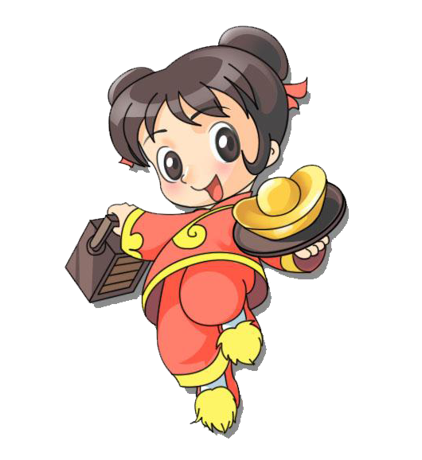
GameFi powered by Millionaire · NFT
NFT
Non-Fungible Token
GameFi became popular with the addition of NFT
Presenting financial products in the form of games, gamifying the rules of DeFi, such as using NFT equipment to increase revenue, introducing battle modes, etc. Compared with traditional liquid mining, GameFi projects are more interactive with users and have Higher interest.
It is indivisible, irreplaceable, unique, etc.

Slide 7
Section 2
About us MAI
Create an ecosystem and token incentive model based on DeFi, NFT, and GameFi

Slide 8

Millionaire · Introduction
Millionaire
DeFi+NFT+GameFi
Create a more innovative and expandable financial platform based on DeFi+NFT+GameFi. Through all-round basic functions and diversified economic models, create a multi-asset interoperable autonomous management system, establish a complete DeFi ecosystem, provide a complete decentralized financial infrastructure, and become the king of aggregate transactions in the DeFi field. The value circulation of encrypted digital currency creates more possibilities, allowing more people to share the benefits of the development of blockchain technology!

Slide 9
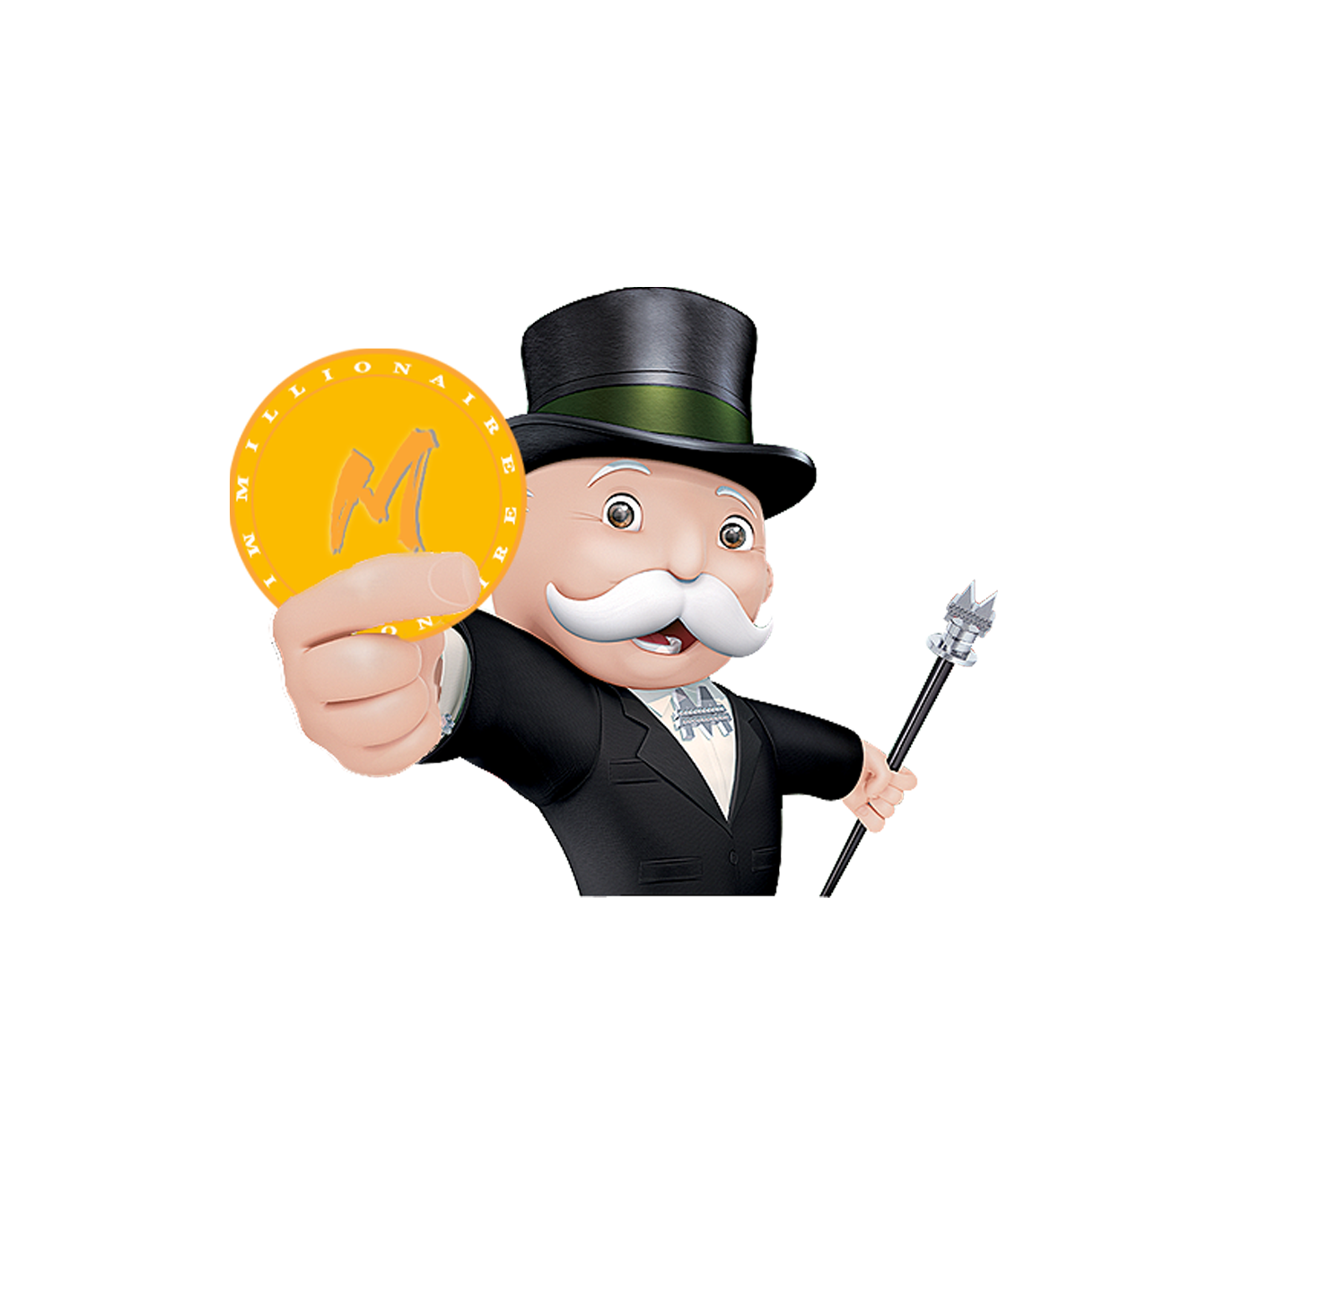
Millionaire · Technological innovation
Original hidden P2P communication network
New data structure
Safe and efficient autonomous consensus mechanism
New anti-quantum attack cryptographic algorithm
Anonymous transaction privacy protection
Advanced Turing complete smart contract
Cross-chain communication and multi-chain integration
Multiple Token distribution methods and methods
Open universal interface

Slide 10
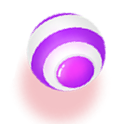
Millionaire · Commercial Landing Plan
Democratic
gaming environment
Game asset
issuance
Game asset
trading
Multi-asset
access
Asset value
protection
Multiple incentive system
System security

Slide 11
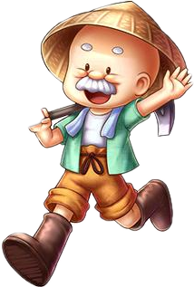
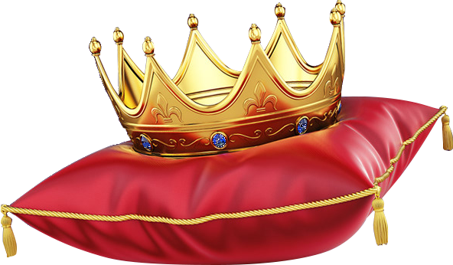
Millionaire · Mission and vision
Establish a fair and open comprehensive
application system
Millionaire's mission is to build a complete value ecology for global users in the blockchain era, and hope that this ecology can provide protection for users' free will and personal value, especially time value. Solve the trust and fairness issues faced by finance, payment, liquidity, pledge lending, and entities' commerce, consumption, entertainment, supply chain, finance, etc., and make the entire competitive environment more fair, open and efficient.

Slide 12
Section 3
Play system
same value Public offering
Create an ecosystem and token incentive model based on DeFi, NFT, and GameFi

Slide 13
5USD God of War game · Win Number
Jackpot
No.888 Win round Prize pool 20%USD
Lucky Number Partial display | No.3 ( 50$ ) No.8 ( 10$ ) No.15 ( 30$ ) No.21 ( 10$ ) No.25 ( 20$ ) No.33 ( 30$ ) No.38 ( 40$ ) No.43 ( 50$ ) No.48 ( 60$ ) No.58 ( 40$ ) No.68 ( 30$ ) No.77 ( 50$ )
Pay bonuses | Winnings are automatically distributed to the purchase address.

Slide 14
Millionaire · Description of Win rules
Win conditions
Number purchased after the drawing time has stopped must match the winning
number to win the prize.
Within the lottery time: the number of the number you purchased is not fixed,
all (finally) the newly purchased number is the number 1, has been purchased.
The number you buy increases according to the number of new purchases made
by all players this round.
（1 + all new N purchases = your number scrolling digits）
Lottery stop: the number you purchased will stop rolling. If your purchased number
matches the winning number,You win the corresponding prize!
A maximum of 10 numbers can be purchased from a single address in each round
The same value public offering
You must participate in the 5USD God of War game to obtain the equivalent MAI governance token, which will be released linearly within 100 days.

Slide 15
Millionaire · Buy fund allocation
Buy player | 5USD Buy 1 Number
5USD Distribution | Inject bonus pool 50% Add the MAI base pool 20% Chain fuel 10% Friend Buy reward 10% Add bonus pool dividend 10%
MAI Public offering | Participate in the 5USD God of War game = Governance token MAI equivalent public offering.

Slide 16
Millionaire · Buy description of fund allocation
链上燃油10%
Inject
bonus pool 50%
Add the MAI base pool20%
Friend
Buy reward 10%
Add bonus pool
dividend 10%
Chain fuel10%
At the end of the round, the prize pool allocates the lucky number prize first, followed by the (888) grand prize number prize.
Smart contracts reaching 10USD are automatically added to the MAI/BNB transaction bottom pool.
It is used to pay for on-chain fuel expenses such as share reward release, airdrop reward release, etc.
Reward each Buy:
Level 1 friend 6%
Level 2 friend 4%
Players who add to the bonus pool will receive a permanent bonus share of all the funds purchased from the number in proportion to the percentage added.

Slide 17
Millionaire · Description of bonus pool fund allocation
Bonus pool 5%-40%
Players Win 50%-85%
Friend Win 10%
Keep 5%-40% of the bonus per round and save it until the next round.
链上燃油10%
Win bonus is automatically paid to the purchase address.
Level 1 Friend 6%
Level 1 Friend 4%
Millionaire · Add bonus pool fund allocation description
Inject bonus pool 90%
Friends add bonus pool reward 10%
MAI repo 10%
All funds added to the bonus pool are injected into the bonus pool in real time.
Level 1 Friend 6% , Level 1 Friend 4%
Buy back MAI from secondary
market every month and destroy it

Slide 18
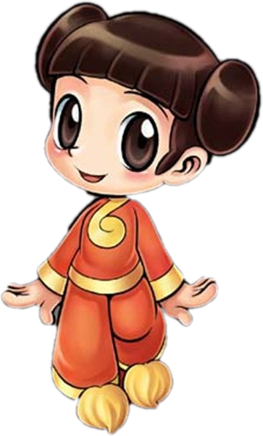
Millionaire · MAI TOKEN Circulation and distribution
MAI:1 billion
Technical team 10%
（Uses: ecological development, maintenance and upgrading, etc.）
Community incentive 10%
（Uses: marketing, community incentive cooperation, etc.）
Game public offering 40%
（Uses:Participate in the game by way of public fundraising.）
Ecological application 40%
（Uses: ecological manager reward, game economic reward, etc.）
MAI is the governance token of the entire Millionaire, and all ecological thresholds are carried out around MAI, which are used to record, transfer and pay accounts in DeFi and more applications in the future.
Release rule: 10% of all assigned items are released each year, and the release is gradually reduced by 10% each year from the second year.

Slide 19
Millionaire · MAI Trading slippage
Buy | 5% Slippage distribution
Level 1 Friend | 3%
Level 2 Friend | 2%
Sell | 5% Slippage distribution
Incineration | 2%
Add LP reward | 3%
Bind friend：Address receives MAI token for the first time and binds the superior and subordinate friend relationship.

Slide 20
Millionaire · Development route
Oct-Dec.2022
June-July.2022
Start MAI third ecology
MAI online trading platform
The secondary market buys back MAI and destroys it
Oct.2021
Create product specifications, UI, and UX
Aug-Sept.2022
Start MAI second ecology
June.2022
Aug.2021
The team building
Project idea
Start MAI first ecology

Slide 21
Millionaire · Future ecology
Real estate tycoon
NFT+GameFi
Play-to-earn
GameFi
Millionaire SWAP
NFT market solutions
Liquidity
aggregation mining
DeFi
Ecology
NFT
Ecology
NFT auction platform
Millionaire machine
gun pool
NFT creation
platform
Pledge lending
NFT Fragmentation
Trading Platform

Slide 22
THANKS
Create an ecosystem and token incentive model based on DeFi, NFT, and GameFi
V1.1 Will be updated continuously, please refer to the latest version.

